Slide 1
LSI and LSA

Slide 2

Latent Semantic Indexing (LSI)
Problem: find best matching documents based on keyword queries
Proposal: retrieval based on the similarity of semantic encodings rather than string comparisons
Method Overview:
Use truncated SVD to characterize the “higher-order structure” in a term-document matrix
Represent each document using $k$largest singular vectors
Represent query using $k$largest singular vectors
Find best matches by (cosine) similarity between query and documents
Notes:
The elements of the term-document matrix are the occurrences of each word in a particular document

Slide 3
Intuition
“The main idea in LSI is to explicitly model the interrelationships among terms [based on their co-occurrence in documents]… and to exploit this to improve [document] retrieval”

Slide 4
Intuition
“the truncated SVD… captures most of the important underlying structure…, yet at the same time removes the noise or variability in word usage”

Slide 5
Intuition
Given the terms:
car
automobile
driver
elephant
car and automobile will occur with many of the same words
driver will overlap somewhat
elephant will overlap very little
Therefore, in semantic space,
car and automobile will be most similar
driver somewhat similar
and elephant dissimilar

Slide 6
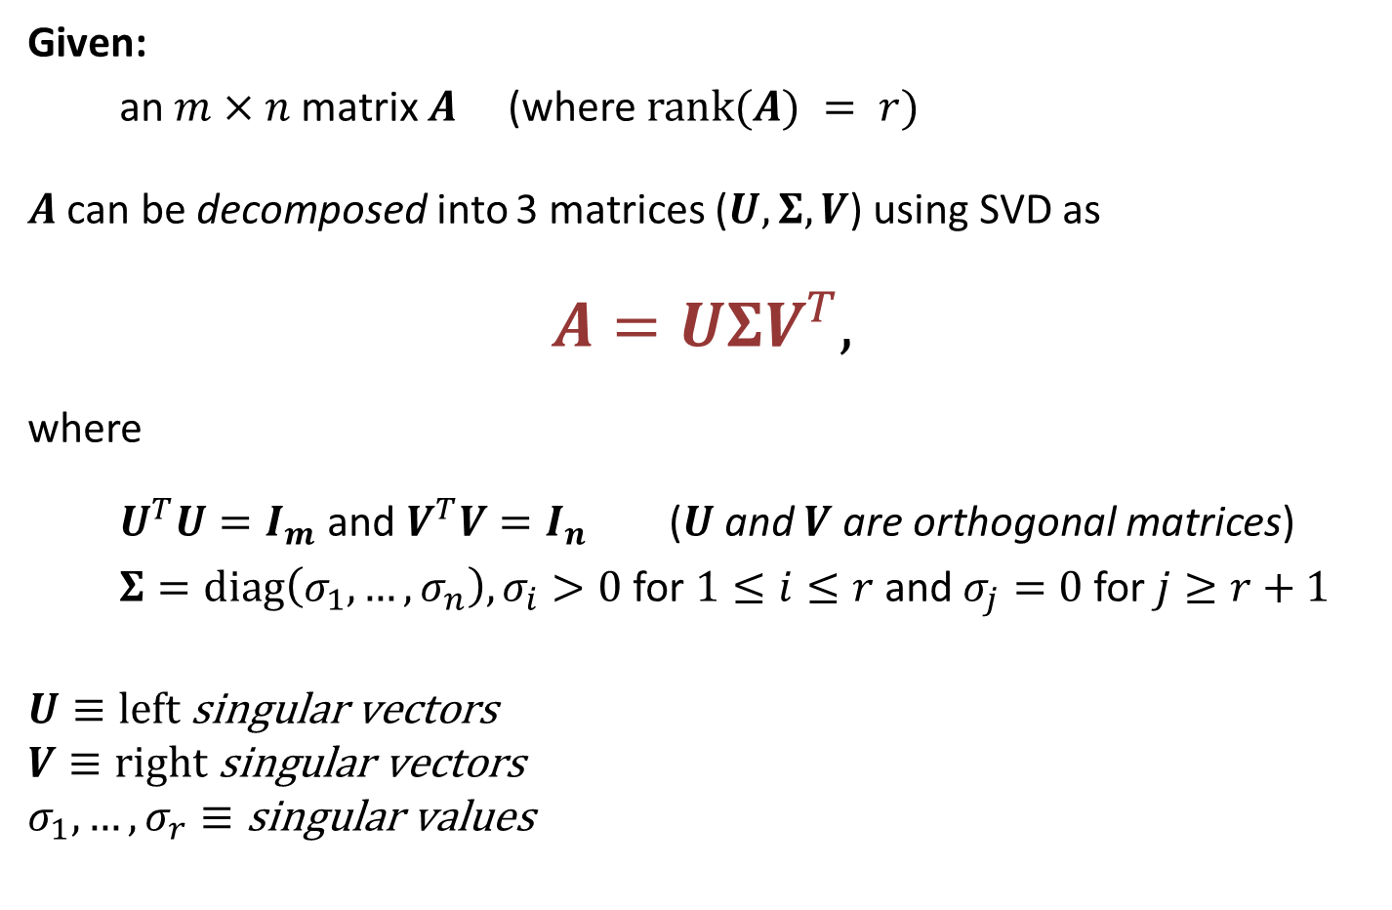
Singular Value Decomposition (SVD)
Given:
an $m×n$ matrix $A$ (where $\text{rank}(A) = r)$
$A$ can be decomposed into 3 matrices ($U, Σ, V$) using SVD as
$$A=UΣV^{T},$$
where
$U^{T}U=I_{m}$ and $V^{T}V=I_{n}$ ($U$ and $V$ are orthogonal matrices)
$Σ=\text{diag}\left(σ_{1},…,σ_{n}\right), σ_{i}>0$for $1≤i≤r$ and $σ_{j}=0$ for $j≥r+1$
$$U≡\text{left} \text{singular} \text{vectors}$$
$$V≡\text{right} \text{singular} \text{vectors}$$
$$σ_{1},…,σ_{r}≡\text{singular} \text{values}$$

Slide 7
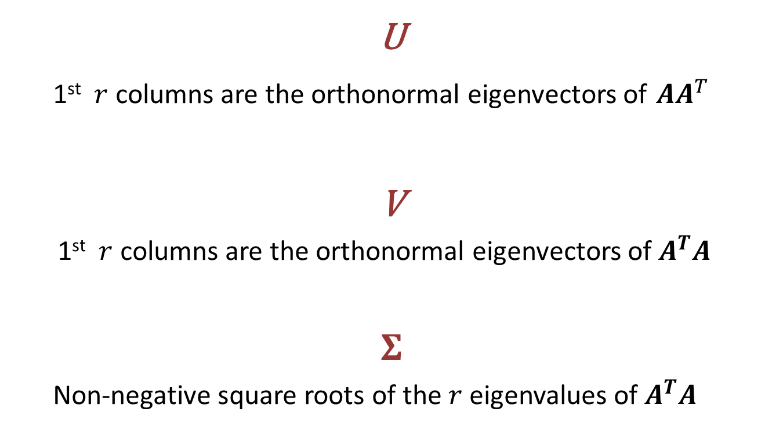
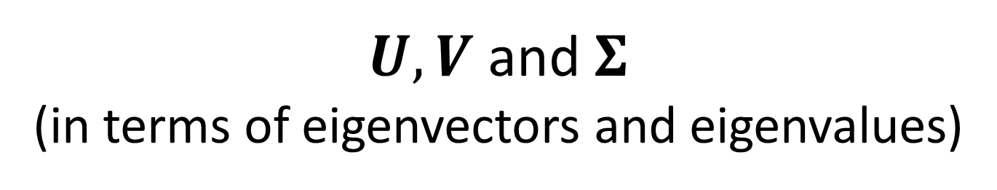
$U,V$ and $Σ$ (in terms of eigenvectors and eigenvalues)
U
1st $r$ columns are the orthonormal eigenvectors of $AA^{T}$
V
1st $r$ columns are the orthonormal eigenvectors of $A^{T}A$
$$Σ$$
Non-negative square roots of the $r$ eigenvalues of $A^{T}A$

Slide 8
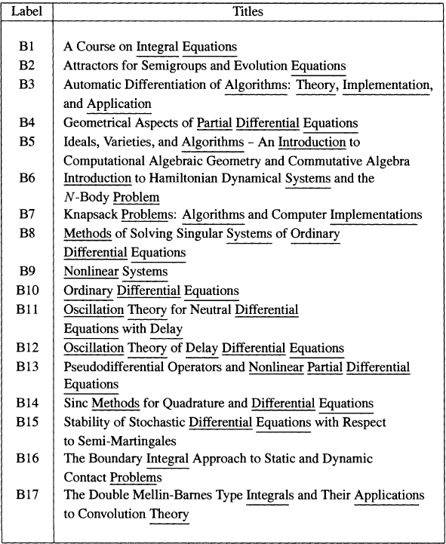
Document
Corpus
Preprocessing:
Only consider words that appear in more than 1 document
Remove functional words (for example, “and” “of”)
Case insensitive
Notes:
Underlined words appear in more than one document
Unique words (such as, “Course” and “Attractors”) and functional words (such as, “and,” “of,” etc.) are ignored
Case insensitive

Slide 9
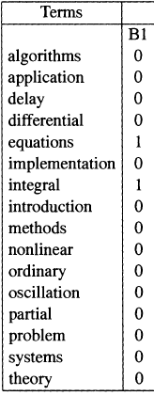

Term-Document Matrices
“A Course on Integral Equations”
encoded as a column vector of $A$
documents are treated as
“bags of words”

Slide 10
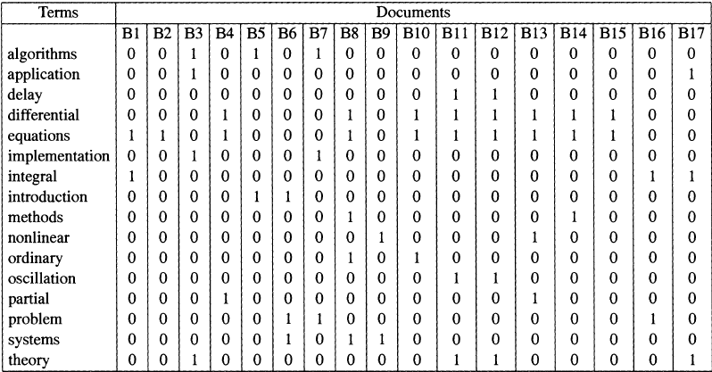
each element in the term-vector matrix is the
frequency of a term’s occurrence in a given document.
Notes:
* this matrix is usually sparse
* local and global term weightings can also be applied

Slide 11
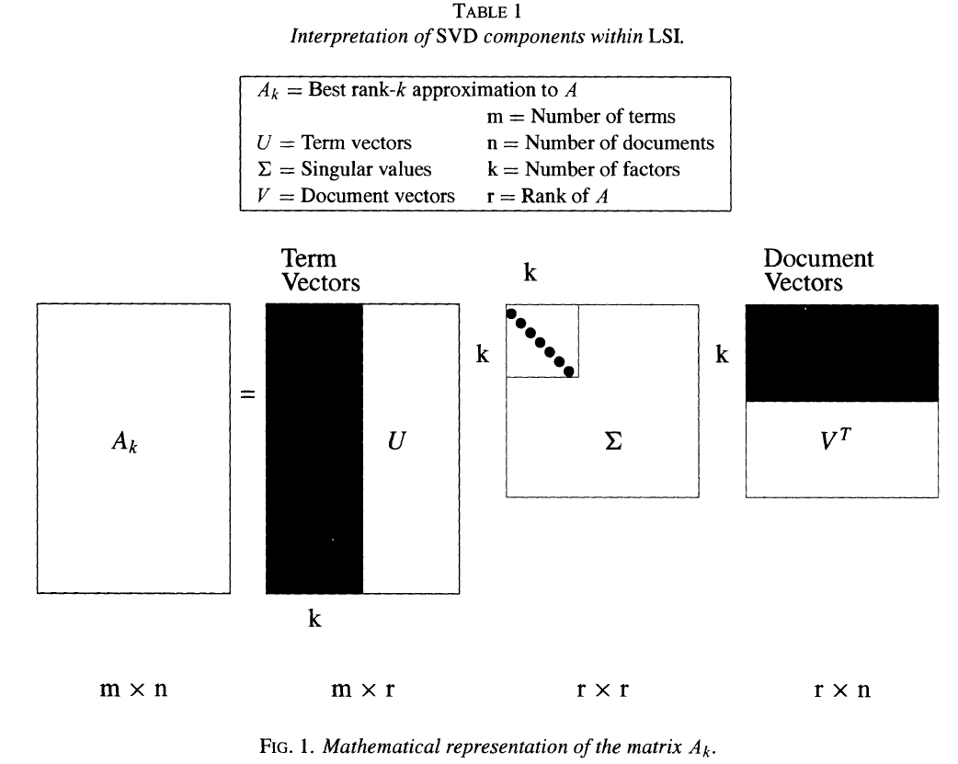

Slide 12
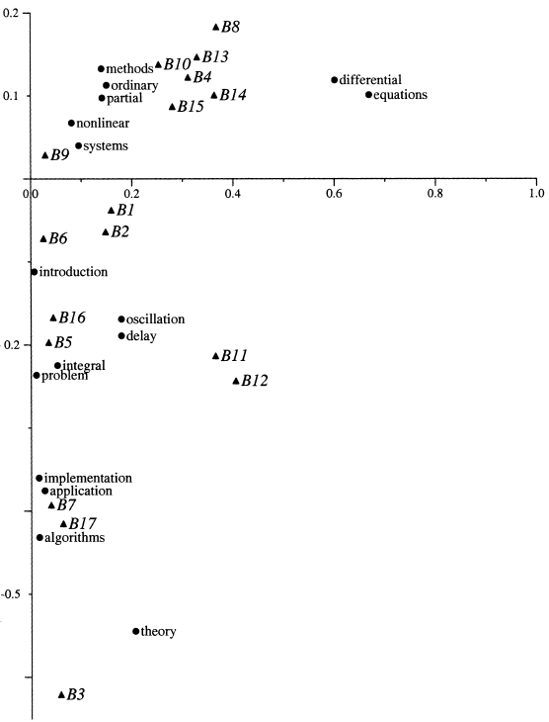
why aren’t
these identical???

Slide 13

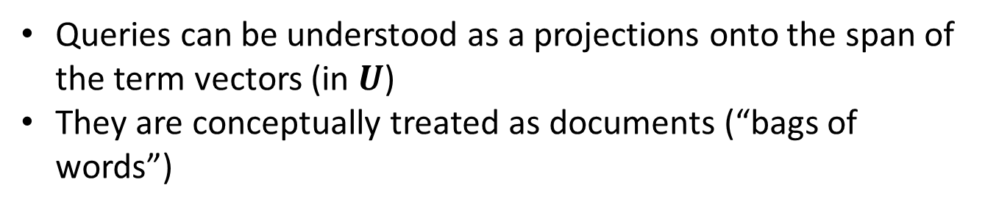
Encoding Queries
Queries can be understood as a projections onto the span of the term vectors (in $U$)
They are conceptually treated as documents (“bags of words”)
$$\hat{q}=q^{T}U_{k}Σ_{k}^{−1}$$
encoded query vector
term
vector
for
query
terms
corresponding
left
singular
vectors
singular values
Notes:
weighted, linear combination of the singular vectors for the query terms
intuitively $q^{T}U_{k}$ is the $k\text{-}\text{dimensional}$ encoding of the search terms and $Σ_{k}^{−1}$ is their relative weights

Slide 14
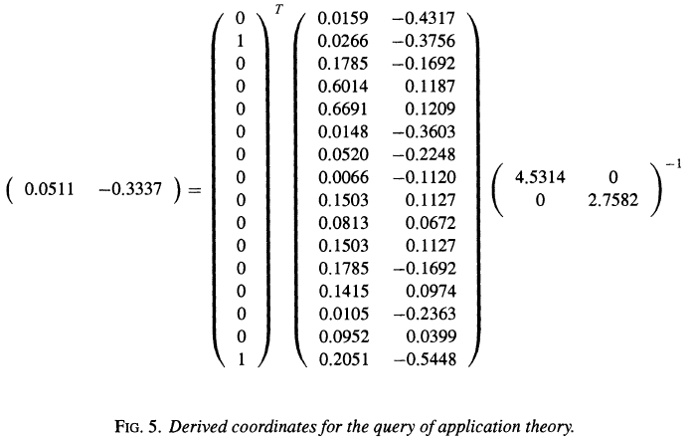






Query Encoding
Given the query: “application and theory”
$$q^{T}$$
$$U_{k}$$
$$Σ_{k}^{−1}$$
$$2×2$$
$$1×16$$
$$16×2$$

Slide 15


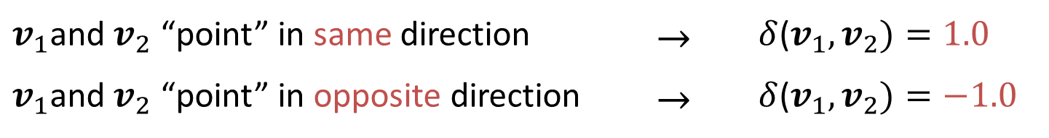
Cosine Similarity ($δ$)
$$δ\left(v_{1},v_{2}\right)=\frac{v_{1}⋅v_{2}}{\left\|v_{1}\right\|‖v_{2}‖}=cos⁡(θ)$$
$v_{1}$and${ v}_{2}$ “point” in same direction | $$→$$ | $δ$($v_{1},v_{2})=1.0$
$v_{1}$and${ v}_{2}$ “point” in opposite direction | $$→$$ | $δ$($v_{1},v_{2})=−1.0$

Slide 16
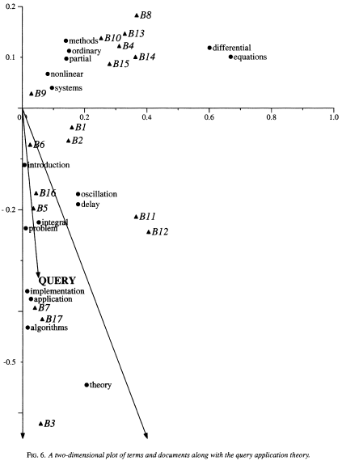
0.9 cosine similarity threshold
Notes:
for the cosine similarity the magnitude of the vector does not matter, only the direction

Slide 17
Notes:
Underlined words appear in more than one document
Unique words (such as, “Course” and “Attractors”) and functional words (such as, “and,” “of,” etc.) are ignored
Case insensitive

